Slide 1

V6 Transition Strategies Protecting IP, Maximizing Existing Investments How Customers Can Safely Move to V6?
Notes:
1
This is the “Presentation title” page. Type the title of your presentation in the "Presentation title” field.
Cette page est la page de titre d’une présentation . Saisissez votre titre dans la zone « Titre de la présentation ».
04/03/2009

Slide 2
Content
Key Messages on V6 Transition
Customer Typology and Supported Scenarios
Early Adopters
Key Take Aways

Slide 3






V6 Transition - Executive Summary
V6 brings critical breakthroughs in the way company works, collaborates and innovates. Be ahead, Think about V6 NOW.
DS will continue to support existing solutions
New V5 releases and service packs are scheduled in 2008/2009
DS is committed to enable a smooth & safe V6 transition
INCREMENTAL & MULTIPLE Approaches: Low V6 adoption risk.
PRODUCTS: Dedicated packages providing a foundation for transition.
SERVICES: Dedicated methods and solutions to assist customers.
ORGANIZATION & SUPPORT: Experts available WW to help customers.
UPGRADES: Portfolio mapping & licensing.
TERMS & CONDITIONS: New contract adapted to today’s business.
V6 is a reality industry readiness & product roadmaps are available enabling DS and customers to define a safe scope for V6 projects
Key customers and partners are already endorsing V6 today
They will showcase real scale transition examples.
Notes:
FMP
1- Reminder: V6 brings critical technology breakthroughs introducing, and supporting, new ways for companies to work, collaborate and innovate. DS has invested aggressively in this new version of its whole portfolio, driven by best-in-class customers’ requirements and supported by the latest technology evolutions. We need of course to continue to expose customers to V6 and identify with them the values V6 will bring to their businesses. If it’s critical to have existing customers think about in V6 NOW, it’s also important to reassured them on the future of their current implementation mixing V4/V5, CATIA/ENOVIA/DELMIA, etc.
On this particular aspect we can today assure them that:
2- DS will continue to support existing solutions including V5 portfolio (CATIA/ENOVIA/DELMIA/SIMULIA FEA), V4 portfolio (CATIA/ENOVIA) and non V4/V5 like MatrixOne and SIMULIA (Abaqus). As proof points you can take some examples including:
German Automotive OEMs which are moving to V5R19 in 2008/2009
ENOVIA Product Manager (PM) and CATIA V4 which have been on the market for 15 years and are still supported. PM will be removed from the DS portfolio next year. CATIA V4 end of support of the current release will be in 2009 too.
3 – DS is committed to support a smooth and safe transition to V6. It can be illustrated through 5 main areas:
* Incremental & Multiple approaches: in order to limit the risk of V6 adoption for existing customers, DS provides different options to move to V6. Data carry over and coexistence scenarios between V4/V5 and V6 are some examples further described later in this presentation.
* Products: a set of transition capabilities is/will also be provided within the V6 portfolio as V6 products. Those capabilities represent a comprehensive foundation to enable a smooth and safe transition from V4/V5 to V6. Customers can use them by themselves and/or in conjunction with services.
* Services: capitalizing on methodologies already tested and used, dedicated transition services are under definition and will further support customers with generic guidelines and implementation roadmap.
* Organization & Support: different customers, different needs, different channels. It is also DS objective to train its experts on how to best support our customers worldwide.
* Product Upgrades: product mapping and licensing have been defined to simplify the transition to V6 and enable customers and sales to quickly identify which package are required and associated cost (if any).
* Ts&Cs: Terms and Conditions have been modified with V6. Customers will have to sign an updated contract with dedicated V6 appendix. Among the various benefits these Ts&Cs will ring to them we can highlight two: one contract for all the DS brands will simplify and streamline our mutual interactions; they will be able to buy licenses and provide them to their suppliers for instance (for the enterprise products) further simplifying the management of complex supply chains.
4 – V6 readiness assessments have been performed from a product and industry stand points. This information is available to our Channels. It enables DS and customers to define a safe scope of their V6 projects. Customers will know where to start and how to roll out a whole project.
5 – Key customers are endorsing V6 today and will showcase real scale transition examples in the coming months. Stay tuned!

Slide 4



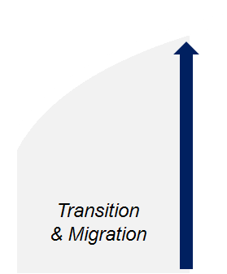

V6 Transition & Lifecycle
Supporting existing solutions while providing a smooth V6 transition
V6
New V5 Releases
& Service Packs
Transition
V5
V5R20
EOS Not Planned
EOL Not Planned
V5R19
Transition
V4
EOS CATIA V4
ENOVIA VPM V4
EOL Not Planned
EOD CATIA V4: 2001
Time
V5R1
V6R2009
EOD: End-of-Development
EOS: End-of-Support EOL: End-of-Life
Notes:
FMP
If we take a look at the different product line lifecycle you can see that we will continue to support existing V4/V5 solutions in the years to come.
* CATIA V4 end-of-support is planned in 2009, while ENOVIA VPM V4 end-of-support is only planned in 2011.
* DS will continue to deliver new V5 releases and service packs and EOS is not planned soon. >> Customers having invested in V5 in the past years can, depending on their situations, continue to invest in those solutions and/or start to implement V6 on new projects for instance.
From a product lifecycle standpoint, what transition means is really helping customers going from the orange / V4 and black / V5 curve to the blue / V6 one. As stated previously DS will provide a strong support to help customers moving forward. This support is in particular illustrated through the two approaches that will help customers move to V6: Migration/Carry Over and Coexistence.

Slide 5
V6 Transition: PRODUCTS
Package of capabilities providing a foundation for transition
Migration and coexistence capabilities are packaged in V6 commercial products.
Data migration / export capabilities comes with V6 default functionalities and can be optionally installed.
Coexistence capabilities require the purchase of add-on products.
Detailed product and capabilities documentation delivered within the regular V6 documentation.
Depending on customer’s environment, specific data / environment preparations may be required.
It can be performed by the customer, after dedicated training, or/and by Professional Services.
Notes:
FMP
Products – migration an coexistence capabilities are provided with the regular V6 packaging.
Migration capabilities are available by default in V6 configurations (no extra charges), whereas coexistence capabilities/products will come with an extra charge.
Those product will come with documentation enabling customer to get familiar with the various functionalities.
In addition, training and services will also be available to further support customers migrating and wanting to coexist with their existing implementation.
Services are described in the next slide.

Slide 6


V6 Transition: UPGRADES
Simplify the migration of existing environments
V4/V5/V6 Portfolio Mapping
Mapping between V5 products / configurations and V6 packaging enables safe upgrades.
Similar mappings exist for MatrixOne 10.x. to V6; V4 to V5.
Licensing Model
Goal of V6 is to go ONLINE: V6 uses primarily Named User licensing.
V6 packaging is organized by roles, each role gets a stack of products according to predefined needs.
iPLM and Authoring bases need to be used full time and are then Named User.
Authoring Vertical Ex.: Advanced Rendering > Shareable
Authoring Base Ex.: CATIA Mechanical > Named User
iPLM Backbone V6 Platform > Named User
Notes:
FMP
Upgrades – They have been defined to help customers replacing their current products in a safe and smoothly manner, from a capability and cost stand points. Portfolios mapping exist for V5, V4 and MatrixOne 10.8. and ensure that customers will get, at least, a similar functional scope compared to what they had in V5/V4/MatrixOne.
Most of the time customers won’t have to pay additional charges (PLC) to migrate. However, in some cases, when for instance the value of the V5 product has been increased in V6, an additional fee may apply.
Licensing in V6 is different, especially for all the Authoring applications which are now primarily relying on a Named User model. Shareable license are also available on some specific add-ons. For customers using extensively concurrent licenses in V5, they may face a cost increase (at equal perimeter). These situations will be at first managed case by case.

Slide 7
V6 Transition Strategies Scenarios
Notes:
7
This is the “Presentation title” page. Type the title of your presentation in the "Presentation title” field.
Cette page est la page de titre d’une présentation . Saisissez votre titre dans la zone « Titre de la présentation ».
04/03/2009

Slide 8


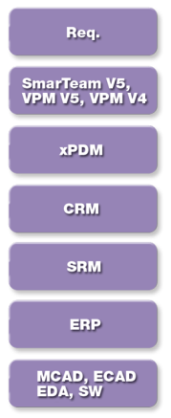
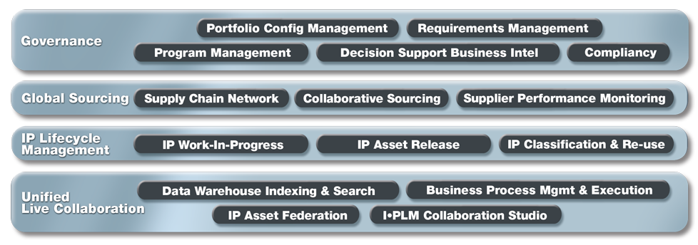






V6 Referential
V6 Transition: Scope of the Presentation
Imagine | Play
Lifelike Experience
Collaborative Innovation
Virtual Design
Realistic Simulation
Digital Manufacturing & Production
Systems
Manufacturing Planning
Shape
Compliance
Plant & Resources Eng.
Mechanical
Multiphysics Digital Lab
Program & Control Eng.
Equipments
Open Scientific Platform
Production Execution
Notes:
8
8
PTQ
Scope of this presentation is for CATIA and ENOVIA. However, similar transition options exist / will exist for DELMIA and SIMULIA.
See the current status for DELMIA at the end of this presentation.

Slide 9
5 Main Scenarios
Control
A - xBOM & Engineering Change Management: Enables a formal collaboration process between Engineering and Enterprise thru a consolidate EBOM and modifications process tracking.
B - Program Management: Enables to conduct and monitor programs / projects by creating Engineering tasks and track their progression.
Coexist
C - CAD Data Management: Leverages the V6 platform to manage CATIA V4/V5 data and lifecycle.
D - Collaborative Design: Enables a tight collaboration between Design teams by sharing design contexts and supporting multi-versions relational design
Migrate
E - Carry Over: Relevant whatever the customer implementation is, DS will provide in the coming releases tools and methodologies to import design data, meta-data, etc into V6.

Slide 10
V6 Transition Strategies Control
Notes:
10
10
This is the “Presentation title” page. Type the title of your presentation in the "Presentation title” field.
Cette page est la page de titre d’une présentation . Saisissez votre titre dans la zone « Titre de la présentation ».
04/03/2009

Slide 11
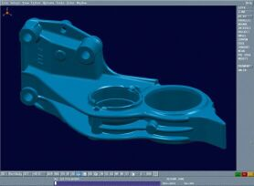
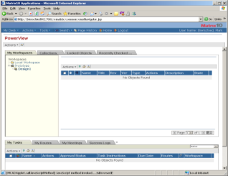
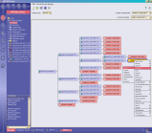

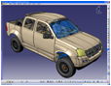
A – XBOM Collaboration & EC Management
Scope
Publish ENOVIA VPM V4 / V5 product structure in the enterprise EBOM through ENOVIA Engineering Central.
Synchronize / update EBOM and VPM V4 / V5 product structure as required by enterprise changes.
Manage engineering changes through ECR/ECO process.
Can also include other CAD components when combined with ENOVIA Designer Central.
Customer’s Benefits:
Consolidate part design content to provide a single definition of the Engineering Bill-of-Material.
Leverage skills and knowledge of the enterprise using a common engineering change management processes.
Easily expandable with additional business processes.
MultiCAD Management, Program Management, Requirements Management, Compliancy, etc.
CATIA V4/V5
ENOVIA 3DLive
Single EBOM Definition
ENOVIA Engineering Central & Variant Conf. Central
ENOVIA VPM V4 / V5
V6 Collaboration Platform
ECR/ECO
Publish
Keep CATIA V4/V5 community on ENOVIA VPM V4 / V5
Create a composite Engineering Bill-of-Material in V6
Orchestrate EBOM / Product Structure modifications
Notes:
FMP
“xBOM Collaboration & Engineering Change Management” goal is to publish and consolidate a single engineering bill-of-material (EBOM) to the enterprise (in V6). It enables also to orchestrate product structure – EBOM changes. This single EBOM can then be reused in downstream processes like manufacturing, services/maintenances, etc.
It’s primarily a process integration focus which goal is to give engineering / in-process work visibility to the enterprise for more efficient product development processes.
Once customers have implemented this process they can add other V6 domains like business processes (Program Management, Requirements management, etc.) as well as authoring applications including CATIA / DELMIA / SIMULIA.
It enables them to continue increasing their CATIA / VPM V4 ROI while putting a first step in V6.
11

Slide 12

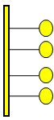
A – XBOM Collaboration & EC Management
Product: ENOVIA X-BOM (VXB)
Scope
xBOM Collaboration
Bidirectional exchange : EV6 xBOM ⬄ VPM product structure
Lifecycle triggered / Mirroring
Part , Product, Configuration (i.e. GBOM, EBOM, CADBOM)
Visualization / Design in Context
Multi-VPM
Transfer Location of Control (change system master)
Engineering Change Choreography
OOTB Adapters
DS ENOVIA VPM V5 Adapter
DS OOTB
Orchestration
(PLM Gateway)
DS OOTB
V6 Adapter
V6 Services
Notes:
Dassault System
12

Slide 13
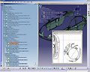
B - V6 Program Management
Scope
Manage product development programs across the enterprise
Can also combine other CAD components thru ENOVIA Designer Central.
Customer’s Benefits:
Execute development programs with greater efficiency due to the availability of in-process design data.
Improve visibility and access to designs early in the development lifecycle to validate product definition.
Disseminate work to designers through their native work environment and receive their deliverables as part of their existing processes.
Easily expandable with additional business processes.
MultiCAD Management, Requirements Management, Compliancy, etc
ENOVIA 3DLive
CATIA V4/V5
ENOVIA Program Management
ENOVIA VPM V5
V6 Collaboration Platform
Keep CATIA V4/V5 community on ENOVIA VPM V5
Create, Manage, Monitor product development programs in V6
Notes:
FMP
The customer keeps its existing ENOVIA VPM V5 implementation as is and add on top of it V6 business processes, especially here the product supporting the “Program Management” process. This integration comes out of the box and represents a smooth way to introduce V6 as it complements the existing implementation vs. replacing it.
13

Slide 14

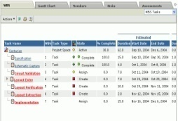
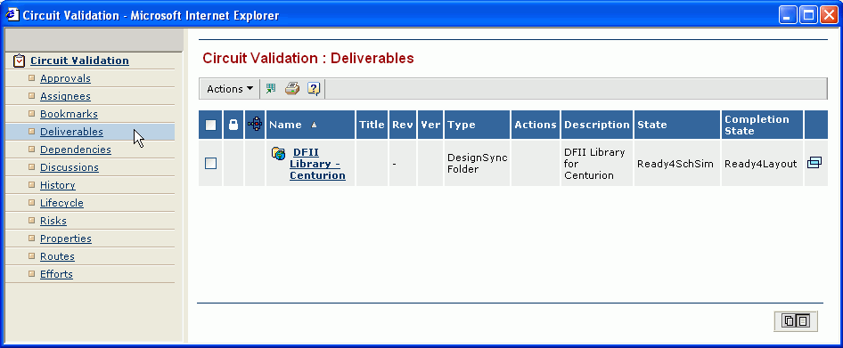
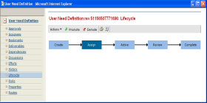
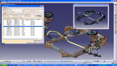
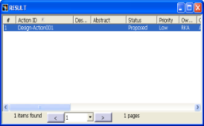

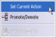
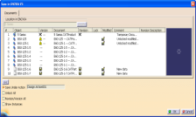
B - V6 Program Management
ENTERPRISE: ENOVIA V6 Business Processes
Program Manager
Creates project including engineering tasks
Search / Navigate VPM V5 objects to attach as task deliverables
Assign tasks & create the Action for designers
In-process work monitored via deliverable attributes
1
2
3
4
ENGINEERING: CATIA V4/V5 & ENOVIA VPM V5
Designer
Complete the Action & rolls-up the affected objects as deliverables and promote the task
Performs work defined in the Action
5
6
Notes:
14
FMP
This scenario illustrates how customer can benefit from program management capabilities on top of an existing CATIA V5, ENOVIA VPM V5 implementation.

Slide 15

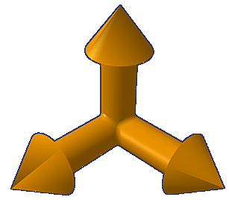
A&B - VXB Roadmap
2009
V6R2010 ⬄ VPM V5 R19 SP3
V6R2010 ⬄ VPM V4 1.6 PTF 12
V6R2010x ⬄ VPM V5 R19
V6R2010x ⬄ VPM V4 1.6 PTF x
2008
V6R2009 ⬄ VPM V5 R18 SP3
V6R2009x ⬄ VPM V5 R18 SP5
2007
EM1 10.7.1 ⬄ VPM V5 R17 SP4
EM1 10.8 ⬄ VPM V5 R17 SP6
VPM V4
Program initialization (Reverse Mirror)
VPM V4 WIP → EV6 X-BOM
Bidirectional X-BOM ⬄ WIP Product Data exchange
Transfer Location of Control
Configuration mapping – X-BOM Centric
Distributed VPM V4 WIP environments integrated with EV6
Not supporting instances using replication
VPM V5
Installer Automation
Distributed VPLM environments integrated with EV6 collaborative environment
Supporting VPLM instances using replication
(Candidates)
Program initialization Enhancements
Split Mirror (for large structures)
EFCS support
Controller consolidation
Bidirectional document lifecycle mapping
Supplier Integration (via EV6)
Program initialization (Reverse Mirror)
VPM V5 WIP → EV6 X-BOM
Work-Package exposure to EV6 X-BOM
Bidirectional multiple customized part domains
Export 3DXML to EV6
Export 2D Drawing to EV6, 2D Drawing Release
VPM V5 Supersede mode support
Distributed VPM V5 WIP environments integrated with EV6 collaborative environment
Not supporting VPM V5 instances using replication
PUE Mapping
Technical Feature ⬄ GCO Mapping
Program initialization Enhancements
Split Mirror (for large structures)
Program initialization (Mirror)
EM1X-BOM → VPM V5 WIP environment
Bidirectional X-BOM ⬄ WIP Product Data exchange
Part # mgmt - EM1 imitated
Multi-CAD Design-in-Context / Configured DMU
Orchestrated Engineering Change Management
Configuration mapping – X-BOM Centric
Transfer Location of Control
Notes:
3/4/2009
15

Slide 16
V6 Transition Strategies Coexist
Notes:
16
16
This is the “Presentation title” page. Type the title of your presentation in the "Presentation title” field.
Cette page est la page de titre d’une présentation . Saisissez votre titre dans la zone « Titre de la présentation ».
04/03/2009

Slide 17
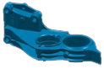
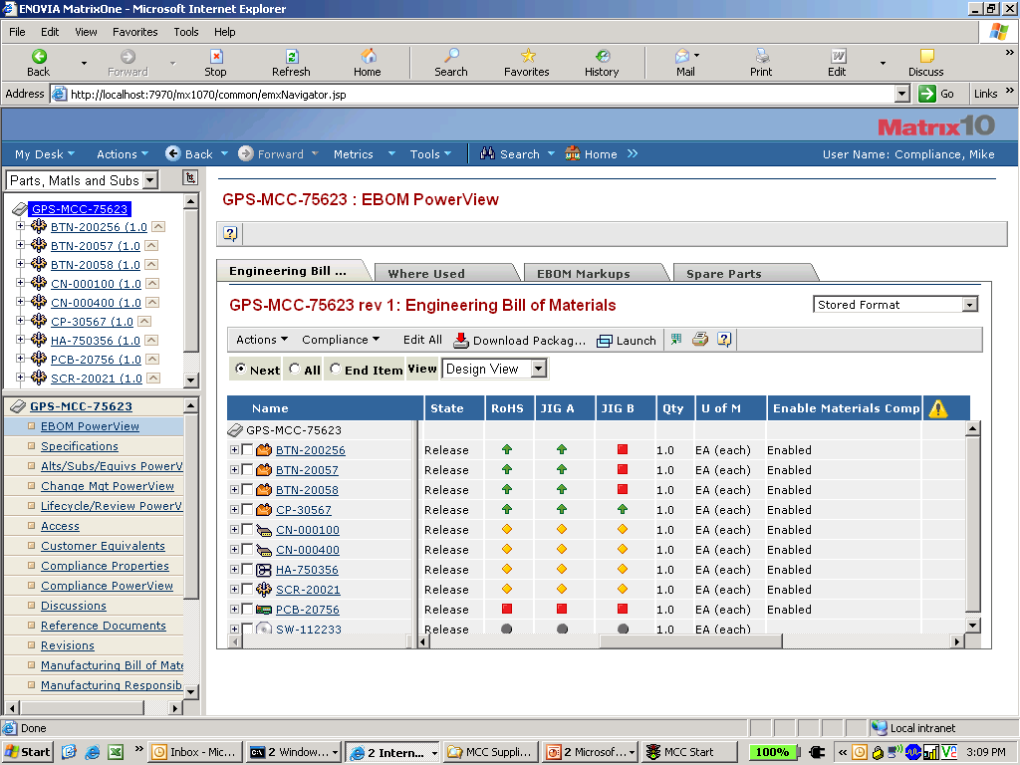
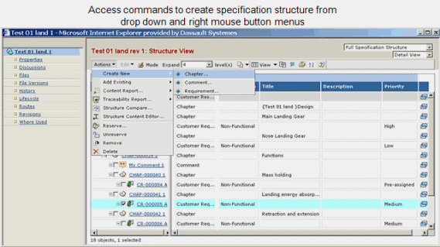
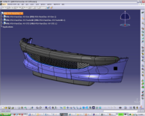
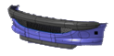
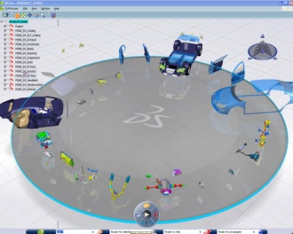
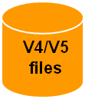
C – CAD Data Management
Manage CATIA V4/V5 Data & Lifecycle in ENOVIA V6
Moving from CATIA V4/V5 file-based to CATIA V4/V5 with ENOVIA Designer Central
Program Management, Requirements Management, Compliancy, etc.
Scope
Data management and concurrent engineering processes:
Check-In / Out; Lock / Unlock;
Versioning; EBOM Sync;
Concurrent engineering,
Etc.
Navigation & collaboration with ENOVIA 3DLive multi-provider.
Customer’s Benefits:
More efficient CAD data and lifecycle management vs. file based.
Easily expandable with additional business processes.
CATIA V4
ENOVIA 3DLive
CATIA V5
CATIA V4/V5
V4/V5 files
ENOVIA Designer Central
V6 Collaboration Platform
Keep CATIA V4/V5 community
Import V4/V5 data in V6 via ENOVIA Designer Central
Manage CATIA V4/V5 Data & Life cycle
Notes:
PTQ
So this slide represent the detail of our first case that is to use your V4 or V5 data in the unique V6 platform and use those data mainly for business process. So this approach is really not CATIA V6 centric.
In term of solution, customers will use ENOVIA Designer Central to manage their CATIA data and lifecycle. They can then benefit from “classic” PDM values. This approach can easily be completed with other V6 business processes, further increasing the scope and value for the customers.

Slide 18
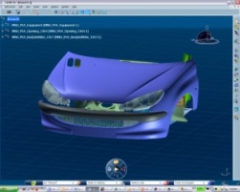
D- Collaborative Design
Scope
Tight collaboration and design reuse between engineering teams working with different version of CATIA:
Use V6 designs in V4/V5 context as well as V4/V5 designs in V6 context.
V4/V5/V6 Relational Design.
Navigation & collaboration with ENOVIA 3DLive multi-provider.
Consolidated digital mockup.
Customer’s Benefits:
Minimize V6 adoption risk
Stepped approach
“Natural” data filtering (only transfer what you really need)
Protect IP and maximize existing investments.
Easily expandable with additional business processes and/or authoring applications.
Collaborative Design Moving from CATIA V4/V5 file-based to CATIA V6
CATIA V4
CATIA V4
CATIA V5
CATIA V5
CATIA V6
CATIA V4/V5
CATIA V4/V5
CATIA V4/V5
CATIA V6
V4/V5 files
V4/V5 files
ENOVIA Designer central
ENOVIA Designer Central
ENOVIA VPM Central
V6 Collaboration Platform
Keep CATIA V4/V5 community
Import CATIA V4/V5 data in V6 via ENOVIA Designer Central
Start new project in CATIA V6 on ENOVIA VPM Central
Design collaboration between V4/V5/V6
Notes:
PTQ
This second scenario represent a step further in term of coexistence of V4/V5/V6. In this particular case, different teams of designers using different versions of CATIA can tightly collaborate on a same design. This scenario is especially relevant for customers wanting to invest in V6 while actively using their existing implementation.
So the message to keep here in term of smart data management is that you are provided with a system that enables you working in the context of data relying to a different platform.

Slide 19
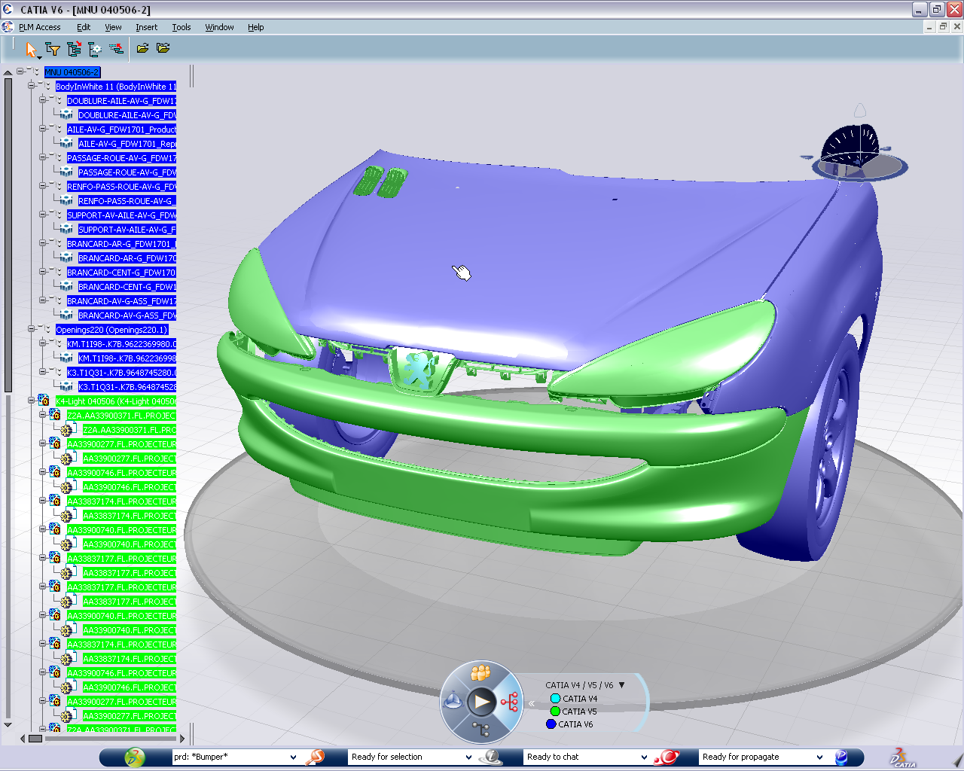
CATIA V4/V5
CATIA V6
V4/V5 files
ENOVIA Designer central
ENOVIA Designer Central
ENOVIA VPM Central
V6 Collaboration Platform
Import CATIA V4/V5 data in V6 via ENOVIA Designer Central
Start designing in CATIA V6 on ENOVIA VPM Central
Design collaboration between the two systems
Notes:
PTQ
This second scenario represent a step further in term of coexistence of V4/V5/V6. In this particular case, different teams of designers using different versions of CATIA can tightly collaborate on a same design. This scenario is especially relevant for customers wanting to invest in V6 while actively using their existing implementation.
So the message to keep here in term of smart data management is that you are provided with a system that enables you working in the context of data relying to a different platform.

Slide 20

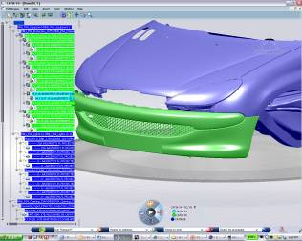
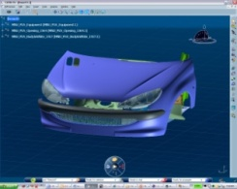
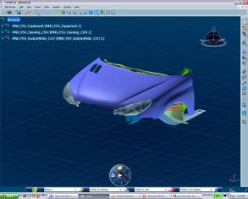
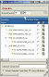
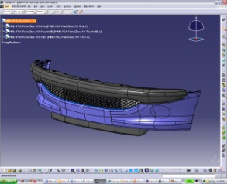


D- Collaborative Design
Collaborative Design: V6 Design as ‘Master‘
CATIA V6 & ENOVIA VPM Central
Designer 1
Build complete assembly
Search and visualize a mixed V4/V5/V6 product structure
Modify V6 data with V4/V5 geometry in context
V4/V5 geometry cannot be modified
Contextual V6 designs, or linked drawings, are updated according to V4/V5 changes (on-demand / automatic)
1
2
3
4
5
CATIA V4/V5 & ENOVIA Designer Central
Publish CATIA V4/V5 data to V6 via ENOVIA Designer Central
Modifications are stored into V6 through ENOVIA Designer Central
Design continues in CATIA V4/V5
Designer 2
Notes:
PTQ
And here is the illustration, so in the top blue area, there is Designer 1 working on the V6 platform with CATIA V6 and storing his data on the ENOVIA V6 unique platform.
In the bottom orange area, there is Designer 2 working either in V4 or in V5 plus ENOVIA Designer central acting as a bridge between the 2 platforms.
Designer 1 can search and build his product structure from V4, but also V5 and of course V6 data.
Designer 2 can access his component stored in V5 with Designer central or look for V6 components.
In both situation, of course the geometry in context cannot be modified. In other words, Designer 1 cannot modified V4 or V5 data, Designer 2 cannot modified V6 data.
But they all take benefit of working in context of the data stored in the other platform.
Thanks to mechanisms delivered within this solution, changes in native platform are propagated in the target platform.

Slide 21
D- Collaborative Design : FBDI&CATDwc usage
V6 Design as ‘Master‘
Supplier adds data:
Eg: new drawing or new parts
Context done by OEM in V6
And sent to the supplier who works in V5
Data are reimported in V6
1
2
3
4
3D shape are exported as « copy with link »
Replace mode on data previously carried over
FBDI works in replace mode on data already migrated
CATDWC
FBDI
OEM
Assy
OEM
CATProduct
OEM
CATProduct
OEM
Assy
OEM
Part
OEM CATPart
import
OEM CATPart
import
OEM
Part
3D Shape
feature
3D Shape
feature
OEM
Part
OEM CATPart
Import
OEM CATPart
import
OEM
Part
3D Shape
feature
3D Shape
feature
SUP
Drawing
V5 work in context of V6 data
SUP CATDrawing
drawing
V6 data
V5 data
Links are automatically rerouted on initial parts
ITERATIONS

Slide 22



D- Collaborative Design
Collaborative Design: V5 Design as ‘Master‘
CATIA V6 & ENOVIA VPM Central
Designer 1
Design in CATIA V6 on ENOVIA VPM Central
Design continues in CATIA V6
Design modifications stored in ENOVIA VPM Central
1
2
3
4
5
CATIA V4/V5 & ENOVIA Designer Central
Build complete assembly with V4, V5 and V6 data through ENOVIA Designer Central
Modify V4/V5 data with V6 geometry in context
V6 geometry cannot be modified
Contextual V4/V5 designs, or linked drawings, are updated according to V6 changes (on-demand / automatic)
Designer 2
Notes:
PTQ
And here is the illustration, so in the top blue area, there is Designer 1 working on the V6 platform with CATIA V6 and storing his data on the ENOVIA V6 unique platform.
In the bottom orange area, there is Designer 2 working either in V4 or in V5 plus ENOVIA Designer central acting as a bridge between the 2 platforms.
Designer 1 can search and build his product structure from V4, but also V5 and of course V6 data.
Designer 2 can access his component stored in V5 with Designer central or look for V6 components.
In both situation, of course the geometry in context cannot be modified. In other words, Designer 1 cannot modified V4 or V5 data, Designer 2 cannot modified V6 data.
But they all take benefit of working in context of the data stored in the other platform.
Thanks to mechanisms delivered within this solution, changes in native platform are propagated in the target platform.

Slide 23
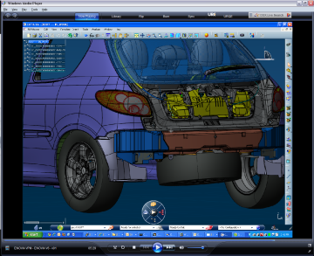
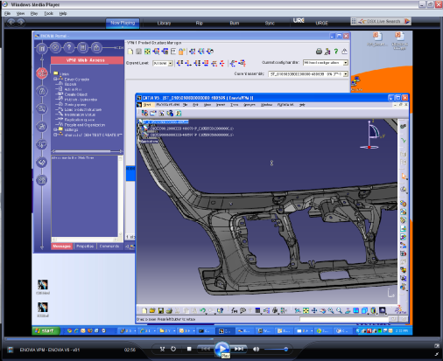
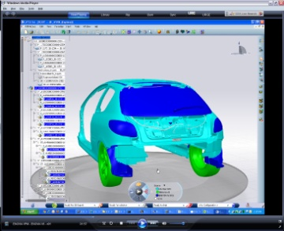
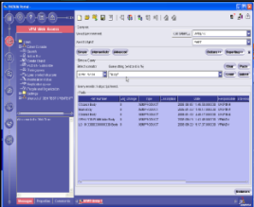
D- Collaborative Design
For ENOVIA VPM V4, V5, SMARTeam
Scope
Tight collaboration and design reuse between engineering teams working with different version of CATIA:
Use V4/V5 designs in V6 context.
V4/V5/V6 Relational Design.
Navigation & collaboration with ENOVIA 3DLive multi-provider.
Consolidated digital mockup.
Similar scenario will also work with multiCAD data through ENOVIA Designer Central.
Customer’s Benefits:
Minimize V6 adoption risk
Stepped approach
“Natural” data filtering (only transfer what you really need)
Protect IP and maximize existing investments.
Easily expandable with additional business processes.
MultiCAD Management, Program Management, Requirements Management, Compliancy, etc.
ENOVIA 3DLive
CATIA V6
CATIA V4/V5
ENOVIA VPM Central
ENOVIA VPM V4 / V5 / SMARTeam
V6 Collaboration Platform
Keep CATIA V4/V5 community on ENOVIA VPM V4 / V5 / ST5
Start new project in CATIA V6 on ENOVIA VPM Central
Design collaboration between CATIA V4/V5 and CATIA V6
Notes:
FMP
“Collaborative Design” enables a tight collaboration between design teams working with CATIA V4/V5 on one side and CATIA V6 on the other one. Design teams can exchange designs, have access to each other design context and can synchronize their design with regards to modifications performed by other designers.
It’s primarily a design collaboration focus which goal is to get design teams work and collaborate efficiently together to develop quicker quality product designs.
Customers can keep using their current CATIA / VPM V4 implementation while starting actively new project on CATIA / ENOVIA V6.

Slide 24
D- Collaborative Design
For ENOVIA V6 Designer Central
Scope
Tight collaboration and design reuse between engineering teams working with different version of CATIA
Use V6 designs in V4/V5 context as well as V4/V5 designs in V6 context.
V4/V5/V6 Relational Design.
Navigation & collaboration with ENOVIA 3DLive multi-provider
Consolidate digital mockup
Customer’s Benefits:
Minimize V6 adoption risk
Stepped approach
“Natural” data filtering (only transfer what you really need)
Protect IP and maximize existing investments
Easily expandable with additional business processes and/or authoring applications
CATIA V4
CATIA V5
CATIA V6
CATIA V4/V5
CATIA V6
ENOVIA Designer Central
ENOVIA VPM Central
V6 Collaboration Platform
Keep CATIA V4/V5 community
Start new project in CATIA V6 on ENOVIA VPM Central
Design collaboration between V4/V5/V6
Notes:
FMP
“Collaborative Design” enables a tight collaboration between design teams working with CATIA V4/V5 on one side and CATIA V6 on the other one. Design teams can exchange designs, have access to each other design context and can synchronize their design with regards to modifications performed by other designers.
It’s primarily a design collaboration focus which goal is to get design teams work and collaborate efficiently together to develop quicker quality product designs.
Customers can keep using their current CATIA / DC5 implementation while starting actively new project on CATIA / ENOVIA V6.
24

Slide 25

D- Collaborative Design
Collaborative Design: V5 Design as ‘Master‘
CATIA V6 & ENOVIA VPM Central
Designer 1
Modify V6 data with V4/V5 geometry in context
V4/V5 geometry cannot be modified
Contextual V6 designs, or linked drawings, are updated according to V4/V5 changes (on-demand / automatic)
Build complete assembly
Search and visualize a mixed V4/V5/V6 product structure
1
2
3
4
5
Design in CATIA V4/V5 on ENOVIA
Modifications are stored in ENOVIA and published in V6
Design continues in CATIA V4/V5
Designer 2
Notes:
25
FMP
Example with V6 as the Master: in the top blue area, Designer 1 works on the V6 platform with CATIA V6 and stores his data on the ENOVIA V6 unique platform. In the bottom orange area, Designer 2 works either in CATIA V4 or in V5 on ENOVIA VPM V5.
Designer 1 builds a complete assembly made up with CATIA V4, V5 and V6 data. He designs in V6 while taking into account V4/V5 contexts. In the same time Designer 2 designs in CATIA V4/V5, and stores his changes in ENOVIA VPM V5. His modifications are propagated within V6 enabling Designer 1 to eventually update and modify his design.

Slide 26


D- Collaborative Design
Detailed Data Flow Description
Search and Visualize V5 and V6 structures
3D LIVE
II
Master CATIA V6 data
X
Design Part and Assemblies with CATIA V6
Y.1
Y
Y.2
Y V6 3DRep
V5->V6
I
Master CATIA V5 data
Slave CATIA V6 data
Design Part and Assemblies with CATIA V5/CATIA V4 and store them into ENOVIAvpm
Build complete assembly with V5 and V6 data
V5 geometry is slave
A
A
B.1
B.CATPart
B.1
B
B
B.2
B.2
B
B.CATPart
B V6 3DRep
V6 Drawing
Associative drawing of complete mixed V5/V6 assembly
V5
V6
ENOVIAvpm
VPLM
Two DataSources
ENOVIAvpm
ENOVIA V6 Foundations
26

Slide 27
D- Collaborative Design
Collaborative Design: V6 Design as ‘Master‘
CATIA V6 & ENOVIA VPM Central
Designer 1
Design in CATIA V6 on ENOVIA VPM Central
Design continues in CATIA V6
Design modifications stored in ENOVIA VPM Central
1
2
3
4
5
Build complete assembly with V5 and V6 data through ENOVIA
Modify V5 data with V6 geometry in context
V6 geometry cannot be modified
Contextual V4/V5 designs, or linked drawings, are updated according to V6 changes (on-demand / automatic)
Designer 2
Notes:
27
FMP
Example with V5 as the Master: in the top blue area, Designer 1 works on the V6 platform with CATIA V6 and stores his data on the ENOVIA V6 unique platform. In the bottom orange area, Designer 2 works either in CATIA V4 or in V5 on ENOVIA VPM V5.
Designer 2 builds a complete assembly made up with CATIA V4, V5 and V6 data. He designs in V5 while taking into account V6 context. In the same time Designer 1 designs in CATIA V6, and stores his changes in ENOVIA V6. His modifications are propagated within VPM V5 enabling Designer 2 to eventually update and modify his design.

Slide 28
D- Collaborative Design Roadmap
V6R2010
General Availability
(To be confirmed)
Next Releases
V6R2009x
Limited Availability
V5 to V6
Product Structure
Exposed Structure
CATPart as CGR
CATPart as Spec
CATproduct
Publication
CATProduct
CATPart
Customized Attributes
Incremental Update
Versioning
Maturity
Ownership
xCad (as CGR) for ST5 & DC5
V6 to V5
Product Structure
Exposed PS
V6 3Drep
Publication
Product level
Customized Attributes
Maturity
Ownership
V5 to V6
Product Structure
Exposed Structure
CATPart as CGR
CATPart as Spec
CATproduct
Publication
CATProduct
CATPart
Customized Attributes
Incremental Update
Versioning
xCad (as CGR) for ST5&DC5)
V6 to V5 (VPMV4/ST5/DC5)
Product Structure
Exposed PS
V6 3Drep
Publication
Product level
Customized Attributes (VPMV4)
V5 to V6
Product Structure
Exposed Structure
CATPart as CGR
CATPart as Spec
Customized Attributes (VPMV4)
Incremental Update (limited)
V6 to V5 (VPMV4/DC5)
Product Structure
Exposed PS
V6 3Drep
Notes:
3/4/2009
28

Slide 29
V6 Transition Strategies Migrate
Notes:
29
29
This is the “Presentation title” page. Type the title of your presentation in the "Presentation title” field.
Cette page est la page de titre d’une présentation . Saisissez votre titre dans la zone « Titre de la présentation ».
04/03/2009

Slide 30
E – Data Carry Over / Migration
Moving from CATIA V4/V5 file-based to CATIA V6
Program Management, Requirements Management, Compliancy, etc.
Scope
Import CATIA V4/V5 data and non CATIA files within ENOVIA VPM Central
Mapping of V5 properties with V6 attributes (default and /or customized mapping)
One shot or incremental import
Customer’s Benefits:
Build strong upfront V6 ROI.
Benefits right away from all V6 values.
Easily expandable with additional business processes.
CATIA V4
ENOVIA 3DLive
CATIA V5
CATIA V6
CATIA V4/V5
CATIA V4/V5
CATIA V6
V4/V5 files
V4/V5 files
ENOVIA VPM Central
FBDI
V6 Collaboration Platform
Import CATIA V4/V5 data in ENOVIA VPM Central
Interactive or
Batch translation
Design in V6
V6 ONLY data
Notes:
PTQ
This last scenario covers the migration / carry over approach.
30

Slide 31
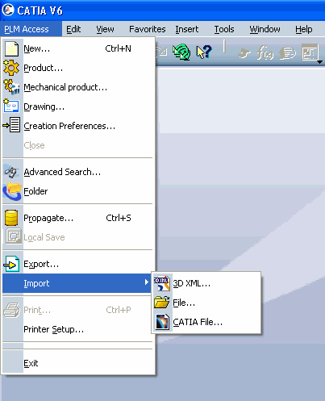
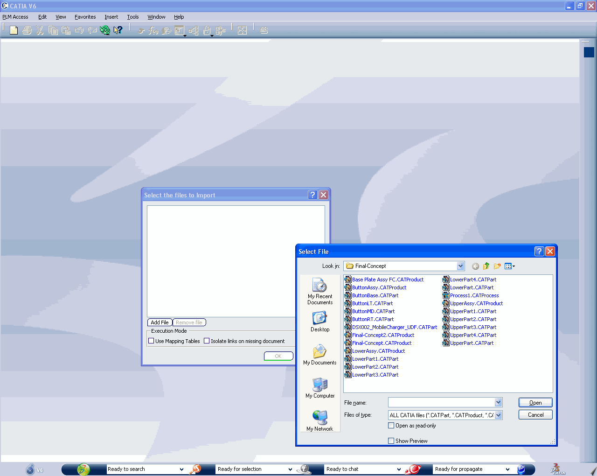
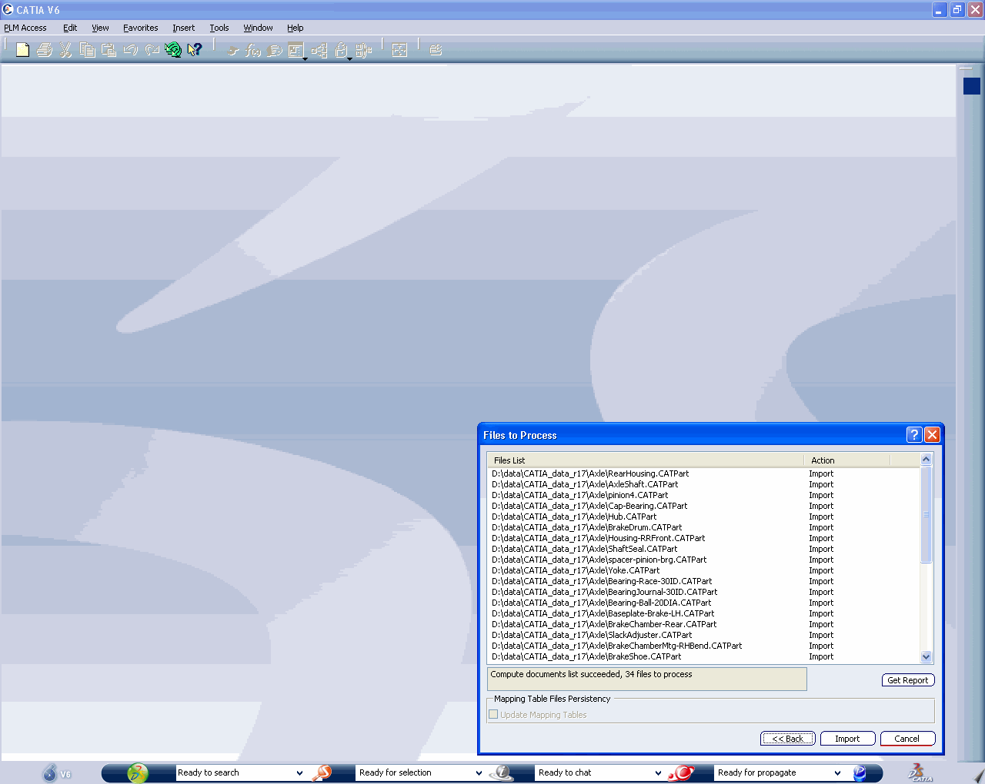
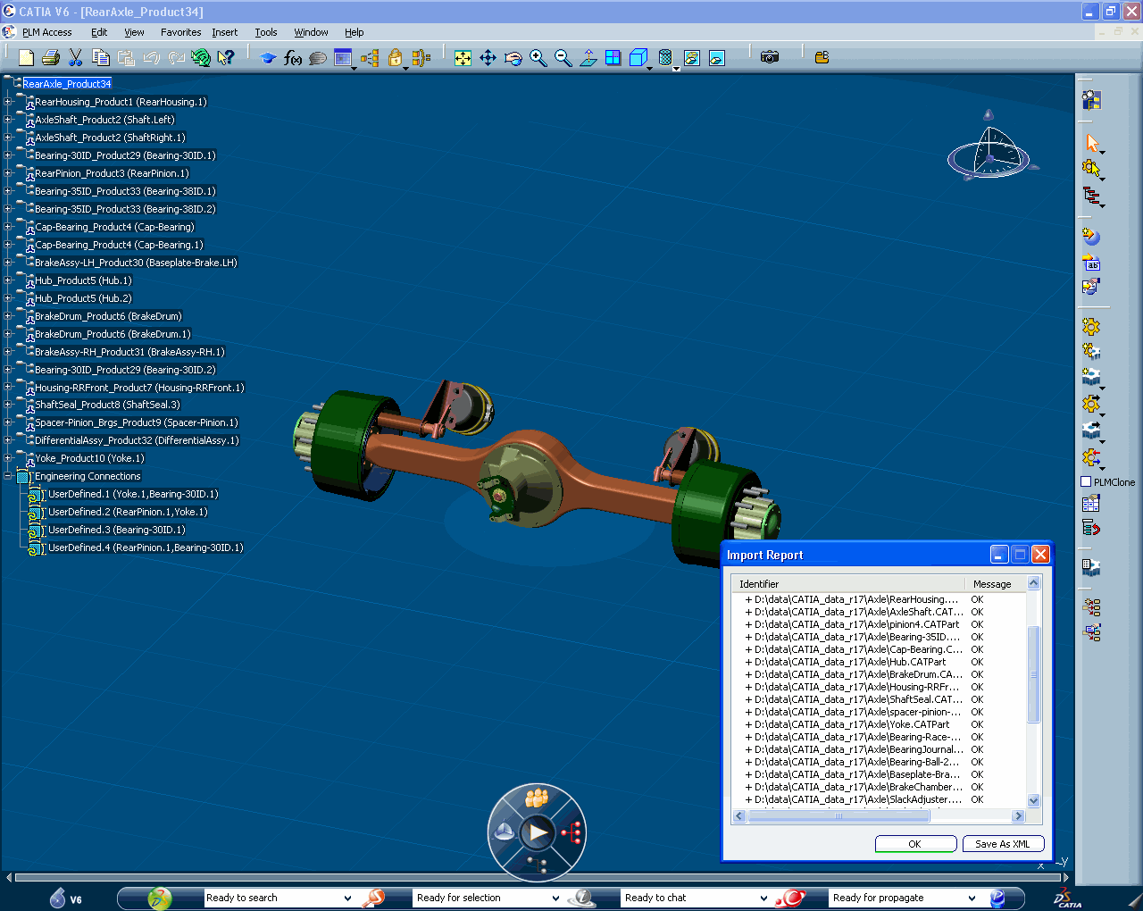
E – Data Carry Over / Migration
CATIA V6 & ENOVIA VPM Central
Convert CATIA V5 data on the fly / batch and store them into V6 database
Select CATIA V5 files from V6
Use migrated data in V6
1
2
3
Notes:
31
PTQ
This slide illustrates how customers using CATIA V5 in a file based mode can import and reuse their data into V6. In that case, the user get rid of this V5 data.
It can be done simply, in 3 steps:
1- Users select the files they want to migrate and they do that directly from a CATIA V6 seat ok.
2- Then the conversion of V5 data can be done either on the fly or in batch depending of course the situation. A big volume of data can be done via a batch a process while a on-demand conversion will likely to be done live. Of course from a V6 platform point of view, once the data are converted, they are V6 data and they are stored in the V6 database.
3 – Once it has been done, users can search, navigate on these data (now V6) , modify them into CATIA V6, reuse them in other business processes, etc.

Slide 32
E – Data Carry Over / Migration
Moving from CATIA V4/V5 & ENOVIA VPMV4/VPMV5/ST5 to CATIA V6
DBDI
CATIA V6
CATIA V4/V5
ENOVIA VPM Central
ENOVIA VPM V4/V5 ST5
V6 Collaboration Platform
Moving from CATIA V4/V5 & ENOVIA DC5 to CATIA V6
CATIA V4/V5
CATIA V6
DBDI
ENOVIA Designer Central
ENOVIA VPM Central
V6 Collaboration Platform
Notes:
FMP
‘Data Carry Over / Migration’ goal is to provide customers with tools and methods to directly import their CAD data and meta-data within V6. To some extend, this is the shortest way to V6.
With V6R2009x customers will be able to migrate the product structure as well as their CATParts, V4 models and CGRs files. Customization is a key concern in this kind of migration and we provide a tool to map VPM V4 customized attributes into V6. V6 customization has to be created. In some cases VPM V4 customization may not be necessary though, as V6 brings additional capabilities compared to VPM V4.
With V6R2010 in addition to the capabilities above customers will be able to migrate their CATProducts, links, external documents and configurations including the options and evolution definition + effectivity.
32

Slide 33
E- Migration Roadmap
V6R2010
General Availability
(To be confirmed)
Next Releases
V6R2009x
Limited Availability
Product Structure
Part
Document
Assembly Links
Data
CATPart
CATProduct
CATDrawing
CATalog
Design table
Non CAD documents
Relational
Doc-Doc links
Contextual links
Assembly constraints
MML Links
Publications exposed
Configuration
Dictionary
Effectivity
Milestones
Versioning
Maturity
Ownership
Product Structure
Part
Document
Assembly Links
Data
CATPart
CATProduct
Relational
Doc-Doc links
Configuration (LA)
Dictionary
Effectivity
Versioning
Product Structure
Part
Document
Assembly Links
Data
CATPart
Configuration
NONE
Notes:
3/4/2009
33

Slide 34
V6 Transition Strategies Conclusion
Notes:
34
This is the “Presentation title” page. Type the title of your presentation in the "Presentation title” field.
Cette page est la page de titre d’une présentation . Saisissez votre titre dans la zone « Titre de la présentation ».
04/03/2009

Slide 35
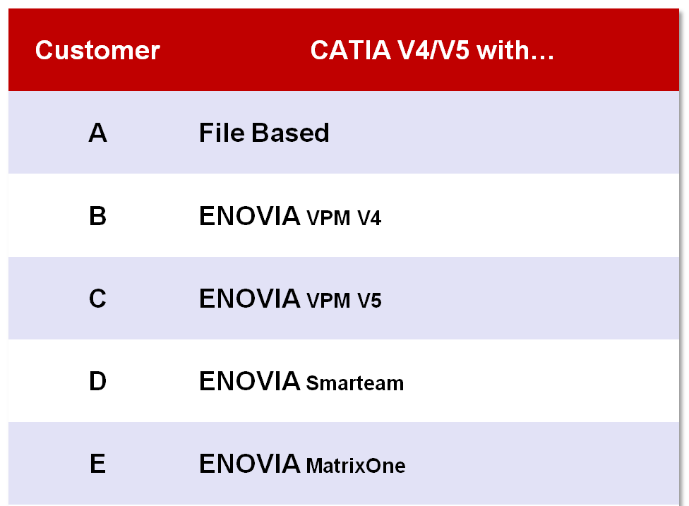
V6 Transition: CATIA/ENOVIA Customers Typology
Notes:
PTQ
So in term of supported scenario, of course they are many different cases.
You may be a CATIA V5 user but you could be on
flat file
You could be on ENOVIA V5, on ENOVIA V4
On ENOVIA Smart team with or without CATIA PLM Express
On MatrixOne
Of course you could be on another PDM system
And same thing, well, with less possibilities but also different cases in V4
Then, it makes the picture quite complex in term of what you can do with which customer.

Slide 36

A – CATIA V4/V5, File Based
V6R2010 Readiness – Q2 2009
Manage CATIA V4/V5 Data & Lifecycle in ENOVIA V6
Collaborative Design
Data Carry Over / Migration
Keep CATIA V4/V5 community
Manage V4/V5 data in V6 through ENOVIA Designer Central
Keep CATIA V4/V5 community
Introduce CATIA V6 for dedicated project or process
Share design context between CATIA V4/V5 and CATIA V6
Design ONLY in CATIA V6 on ENOVIA VPM Central
Reuse / carry over CATIA V4/V5 parts in V6
To be confirmed
General Availability
Limited Availability
Notes:
PTQ
We can at least give a certain number of element in that transition process.
First of all, there are different aspect, some people will do a full migration that will take all their data on V4, all their data on V5 and they will put every thing on V6, getting rid of their PLM platform. That’s I would say the full migration solution. And that can happen.
But you have others solutions, you can use V5 & V6 at the same time and you can do that in different ways:
- You can do CATIA data management in V6 and I would say this is from a pure CATIA perspective not something that we are going to encounter that much. This is the way of putting all your V4 data, all your V5 data in the V6 platform and make them connected to this platform.
You can do collaborative design between V4, V5 and V6. So in this case you keep your data on their native platform and using ENOVIA tools you made V4, V5 data available in V6 and reversely

Slide 37
B - CATIA V4/V5, ENOVIA VPM V4
To be confirmed
V6R2010 Readiness – Q2 2009
xBOM Collaboration & Engineering Change Management
Data Carry Over / Migration
Collaborative Design
Keep CATIA V4/V5 community on ENOVIA VPM V4
Create in V6 a composite Engineering Bill-Of-Material including CATIA V4/V5 parts.
Orchestrate EBOM / Product Structure modifications
Design ONLY in CATIA V6 on ENOVIA VPM Central
Reuse / carry over CATIA V4/V5 parts in V6
Keep CATIA V4/V5 community on ENOVIA VPM V4
Introduce CATIA V6 for dedicated project or process
Design collaboration between CATIA V4/V5 and CATIA V6
General Availability
Limited Availability
Proof-of-Concept

Slide 38
C - CATIA V4/V5, ENOVIA VPM V5
V6R2010 Readiness – Q2 2009
V6 Program Management
xBOM Collaboration & Engineering Change Management
Data Carry Over / Migration
Collaborative Design
Keep CATIA V4/V5 community on ENOVIA VPM V5
Start managing product development programs in V6
Keep CATIA V4/V5 community on ENOVIA VPM V5
Create in V6 a composite Engineering Bill-Of-Material including CATIA V4/V5 parts
Orchestrate EBOM / Product Structure modifications
Design ONLY in CATIA V6 on ENOVIA VPM Central
Reuse / carry over CATIA V4/V5 parts in V6
Keep CATIA V4/V5 community on ENOVIA VPM V5
Introduce CATIA V6 for dedicated project or process
Design collaboration between CATIA V4/V5 and CATIA V6
To be confirmed
To be confirmed
General Availability
Limited Availability
Proof-of-Concept
Notes:
FMP

Slide 39
D – CATIA V5, ENOVIA SmarTeam
V6R2010 Readiness – Q2 2009
Collaborative Design
Data Carry Over / Migration
Keep CATIA V5 community on ENOVIA Smarteam V5
Introduce CATIA V6 for dedicated project or process
Design collaboration between CATIA V5 and CATIA V6
Design ONLY in CATIA V6
Reuse / carry over CATIA V5 parts in V6
To be confirmed
General Availability
Limited Availability
Proof-of-Concept
Notes:
FMP

Slide 40
E – CATIA V4/V5, ENOVIA Designer Central
V6R2010 Readiness – Q2 2009
Designer Central Upgrade
Collaborative Design
Data Carry Over / Migration
Keep CATIA V4/V5 community
Upgrade Designer Central to the latest V6 level
Keep CATIA V4/V5 community
Introduce CATIA V6 for dedicated project or process
Design collaboration between CATIA V4/V5 and CATIA V6
Design ONLY in CATIA V6
Reuse / carry over CATIA V4/V5 parts in V6
To be confirmed
General Availability
Limited Availability
Proof-of-Concept
Notes:
FMP

Slide 41
V6 Transition & Early Adopters
Context: CATIA V5, Files & ENOVIA VPM V5
Entry Strategy:
Multisite Collaboration and CATIA
Transition Path:
Migration of a new project in V6
Multisite collaboration
Carry over V5 data on demand
Full migration of remaining V5 data
Stop V5
Context: CATIA V5/V4, ENOVIA VPM V4
Entry Strategy
Multisite Collaboration
Transition Path:
CATIA V6 on new site with remote access
Carry over V4/V5 data on demand
Collaborative Design between V4/V5 and V6 (future)
Context: CATIA V5, ENOVIA VPM V5
Entry Strategy
Business Processes with ENOVIA V6
Transition Path:
Program Management for VPM V5
Connect engineering & enterprise teams thru xBOM Collab. (V6<>VPM V5)
Introduce CATIA V6
Context: CATIA V5, xPDM, xCAD
Entry Strategy:
Design with CATIA V6 (w/ VPM Central)
Transition Path:
Start new project in CATIA V6 (isolated)
Carry over V5 and xCAD data on demand from xPDM
Migrate other departments on V6
Notes:
FMP

Slide 42

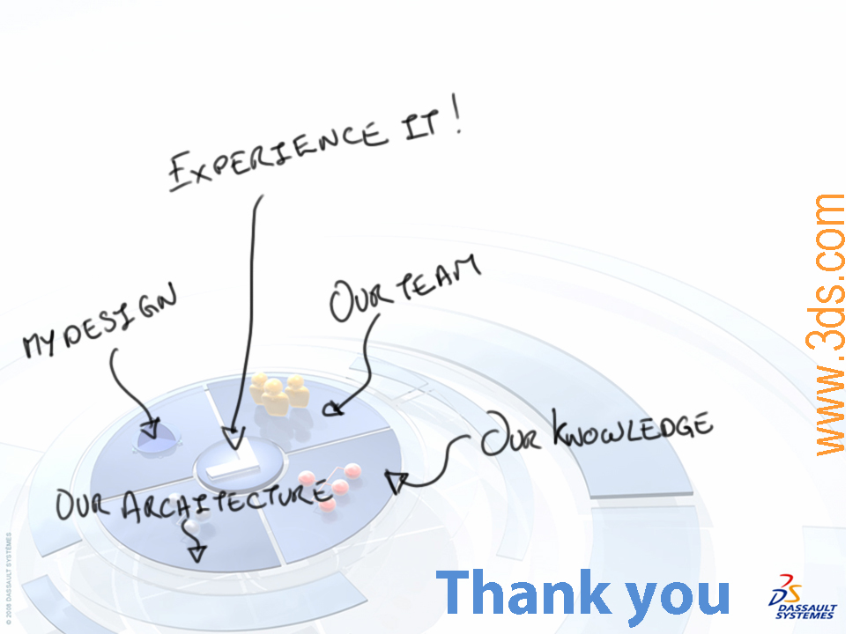
Notes:
42
[The signature should start automatically]

